Slide 1
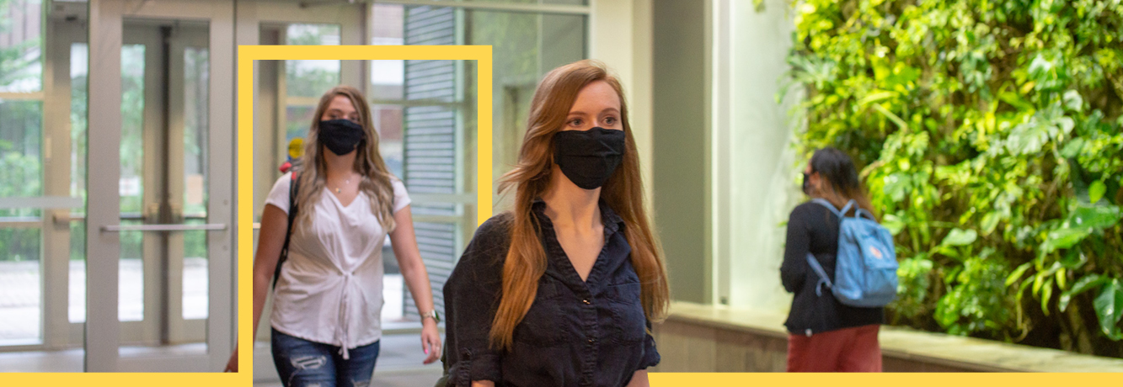
CLASSROOM EXPECTATIONS
Winter term 2022

Slide 2

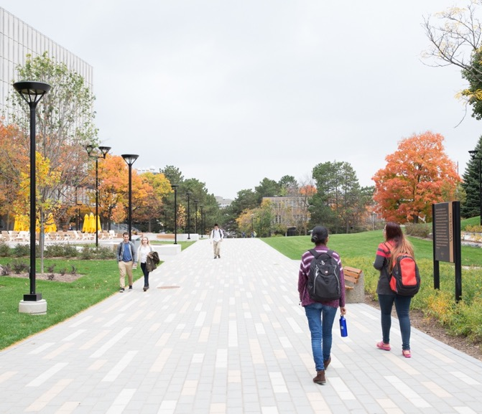
Our shared responsibility
We all have an important part to play in limiting the risk of COVID-19 and maintaining safety on campus.
Please remember to follow public health guidance and these classroom expectations, and to respect each other as we share the space in our classroom.
Continue to monitor your email for important updates to provincial regulations and what this means for changes on campus
FIND THE LATEST INFORMATION
uwaterloo.ca/coronavirus/health-and-safety

Slide 3
BEFORE COMING TO CLASS
  DO NOT attend class if:
    You are ill
    You have been in close contact with someone who is ill or has tested positive for COVID-19
    You have travelled outside of Canada within the past 14 days

Slide 4
CAMPUS CHECK-IN
  Campus Check-In will help us monitor building occupancy and trace contacts if there is a positive COVID-19 case on campus
  How to check-in
    Automatic check-in (recommended): connect to eduroam wireless network.
    Manual check-in: complete the Campus Check-In form at checkin.uwaterloo.ca every day you visit campus and for every building you visit.
  Policy 46 - Information Management and the Guidelines on Use of Waterloo computing and network resources protect any personally identifying information that eduroam collects.
Notes:
(More background on campus check in)
How Campus Check-In works
You can choose to log your attendance in campus buildings using the automatic or manual recording options.
Automatic recording of details (recommended option): The automatic reporting option uses the eduroam wireless network. Any device (i.e. phone, tablet, laptop) you connect to the campus Wi-Fi will automatically record your username, building access point (location), and time of connection. You don’t need to do anything else if you choose this option.
Manual recording of details: If you do not have a Wi-Fi enabled device, or choose not to connect to eduroam, you must complete the Campus Check-In form. You will be asked to record the buildings you visited and the times you arrived and left. You must complete this form every day you visit campus and for every building you visit.
If you don’t normally have access to any kind of device or computer that can access this tool, please speak to your supervisor about a plan to record your building visits.
Campus Check-In will allow us to meet guidelines from the Government of Canada for post-secondary institutions during the COVID-19 pandemic. Reviewed by Region of Waterloo Public Health, the tool is available to all students, employees, and visitors, and will help us:
provide students and employees with a reminder to conduct a health self-assessment each day of planned attendance on campus,
support local Public Health authorities with contact tracing responsibilities,
assist units in evaluating the success of their return to campus plans,
allow the University to identify potentially overcrowded areas, and
support Plant Operations building management for custodial services and energy use.
Protecting your privacy
The privacy of our community is of utmost importance. Policy 46 - Information Management and the Guidelines on Use of Waterloo computing and network resources protect any personally identifying information that eduroam collects.
Occupancy reporting: We will make building and departmental occupancy level reports available to campus leaders to assist in evaluating return to campus plans. For privacy reasons, these reports will include only non-identifying data in aggregate form (e.g. overall number of people in a building).
Contact tracing: In the event a member of the University community tests positive for COVID-19, our Health Services and Occupational Health teams will use data from more detailed reports to contact anyone who may have come in close contact with COVID-positive cases in our community.
Visit the COVID-19 Information website to learn more about Campus Check-In.
You can send questions about Campus Check-In or any other campus safety issues to coronavirus@uwaterloo.ca.

Slide 5
CAMPUS CHECK-IN: SCREENING ASSESSMENT
Take the mandatory COVID-19 screening assessment.
You will get an email with a link to the screening questions check in via eduroam or when you complete the manual Campus Check-In form.
  If you pass the screening questions, you may access campus.
  If you fail the screening questions, you must return home to self-isolate immediately.
  If you do not complete the screening questions upon arriving to campus, you will receive reminders to do so until complete.
Notes:
The University is updating its COVID-19 screening processes to align with regulations the Ontario government recently announced.
Effective Monday, November 30, 2020, you must complete the new screening questions before accessing campus. You will get an email with a link to the new screening tool when your device connects to the campus wireless network (eduroam) or when you complete the manual Campus Check-In form.
If you pass the screening questions, you may access campus, following established safety practices.
If you fail the screening questions, you must return home to self-isolate immediately. You will receive a follow up email from the University outlining support resources and next steps.
If you do not complete the screening questions upon arriving to campus, you will receive reminders to do so until complete. We will monitor compliance to the screening requirement and your access to campus may be removed if you fail to complete the assessment.

Slide 6

IF YOU ARE ILL OR HAVE BEEN EXPOSED TO COVID-19
If you are sick, experiencing any symptoms of COVID-19, or if you have been exposed to someone who has tested positive for COVID-19:
  Stay home. If you’re on campus, go home immediately.
  Inform your instructor of your absence and contact the Health Services COVID-19 Centre at HS-SOS@uwaterloo.ca.
  Follow the directions provided by your health care providers, including any testing, contact tracing and quarantine or isolation instructions.
  Do not return to work or class until you receive clearance to do so from your health care provider.

Slide 7
IN THE CLASSROOM
Face coverings
You must wear a proper face covering (e.g., a mask) in common use areas on campus, including classrooms and labs.
No food is allowed to be consumed during the class.
Beverages are allowed.
Notes:
More info on face coverings:
All employees, students, visitors and contractors are required to wear a face covering in common use areas of University buildings.
This includes corridors, lobbies, washrooms, elevators, classrooms, teaching laboratories and meeting rooms, or in any area where physical distancing is a challenge. In employees-only areas, managers will set the expectation with their teams based on physical setup and work activities.
A face covering is defined as a medical or non-medical mask or other covering, including a bandana, scarf or other fabric that covers the nose, mouth and chin to create a barrier to limit the transmission of respiratory droplets.
This requirement to wear a mask does not apply:
-to people who are unable to wear a mask due to a medical condition or disability
-to children under the age of 5
-when communicating with a person who is hearing impaired and the ability to see the mouth is essential for communication
-when wearing a face covering would create a risk to the wearer related to their work, as determined by workplace safety guidelines.

Slide 8
IN THE CLASSROOM
General protocol
There are no capacity limits for classrooms this winter.
Physical distancing is not required in academic spaces such as labs, classrooms, and libraries; however your mask must be worn at all times.
Please be mindful of potential accessibility concerns, and do not take to enforcing the mask mandate with specific individuals.

Slide 9
PHYSICAL DISTANCING
  Maintain physical distancing while entering and exiting the classroom or lab. Physical distancing is still required in all common areas.
  You can enter and exit the room at leisure.

Slide 10
HAND
HYGIENE
Practice frequent hand hygiene before coming to class.
Wash your hands frequently with soap and running water.
When soap and running water are not available,
an alcohol-based hand sanitizer is a good alternative.

Slide 11
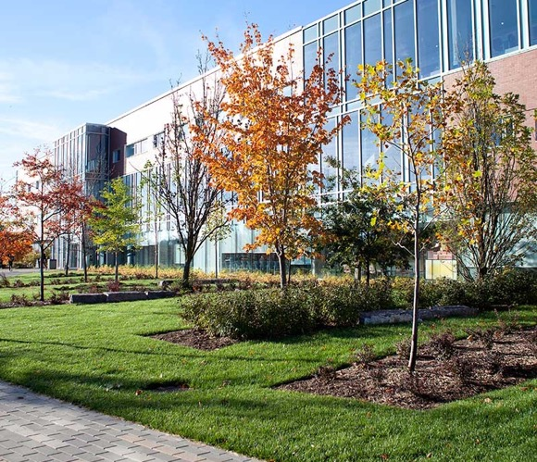


STAY INFORMED
COVID-19 WEBSITE
RETURNING TO CAMPUS GUIDE
WATSAFE APP
uwaterloo.ca/covid-19 | Your official source for COVID-19 information and procedures at UWaterloo.
publications.uwaterloo.ca/welcome-back-waterloo | Learn about the University’s plans and the steps you can take to keep safe.
WatSAFE provides quick and convenient access to campus safety and emergency resources. (Download from your app store.)
Notes:
https://uwaterloo.ca/covid-19
https://publications.uwaterloo.ca/welcome-back-waterloo/
https://uwaterloo.ca/watsafe/
You can also refer students to this video: https://www.youtube.com/watch?v=atlP3uevxjQ&feature=youtu.be

Slide 12


